Slide 1
History of Idealism is the History of coming to terms with the established order
CULTURE is that negotiation
It mediates between Idealism and material conditions of exploitation and profiteering

Slide 2
Desert of the Real
Here, sameness is essential
Rather minute differences that ultimately produce sameness
Fashions that produce a rhetoric of individual choice
We basically watch the same movie again and again
Egs. Modern day ones – Ranbir Kapoor’s entire career is about watching a grown petulant boy hopefully becoming a man
Beards, Slim Pants, Coffee, Trekking, photography, Graphic Design – Hipster

Slide 3
A universally obligatory, eternally better, more valuable world must constantly be affirmed – a world removed from the facticity of daily struggles, yet realizable from within each individual without transforming the world
“Civilization and Culture” – where Sublime Beauty and antagonistic relations of existence are stabilized and pacified

Slide 4
Culture – Supposed to be concerned with every individual’s claim to happiness
Root of Culture – hierarchies of antagonisms
Society reproduces itself through economic competition
Here, happier social existence is rebellion – Maruti factory, Amazon, Bangladeshi Sweatshops, women vs goddesses, Refugees vs migrants

Slide 5
Culture belongs to he who has internalized a proper mode of behaviour
He who comprehends the truths of humanity as battle cry is a rebel (Nargis vs Satyajit Ray)
Culture – ennobles, speaks of the dignity and freedom of man without freeing him

Slide 6
Beauty and truth, contemplation and intellection then are “cultural” activities
Both sublimated and internalized
Neither forms allow real material conditions to change
Culture perpetuates forms of systemic/epistemic oppression

Slide 7
At the same time, culture is that which escapes the confines and language of power disrupting the narrative of political and capitalist formation.
Such escapes are short lived, and quickly co-opted
“Azaadi Song” – Kanhaiya Kumar, Dub Sharma, Gully boy

Slide 8
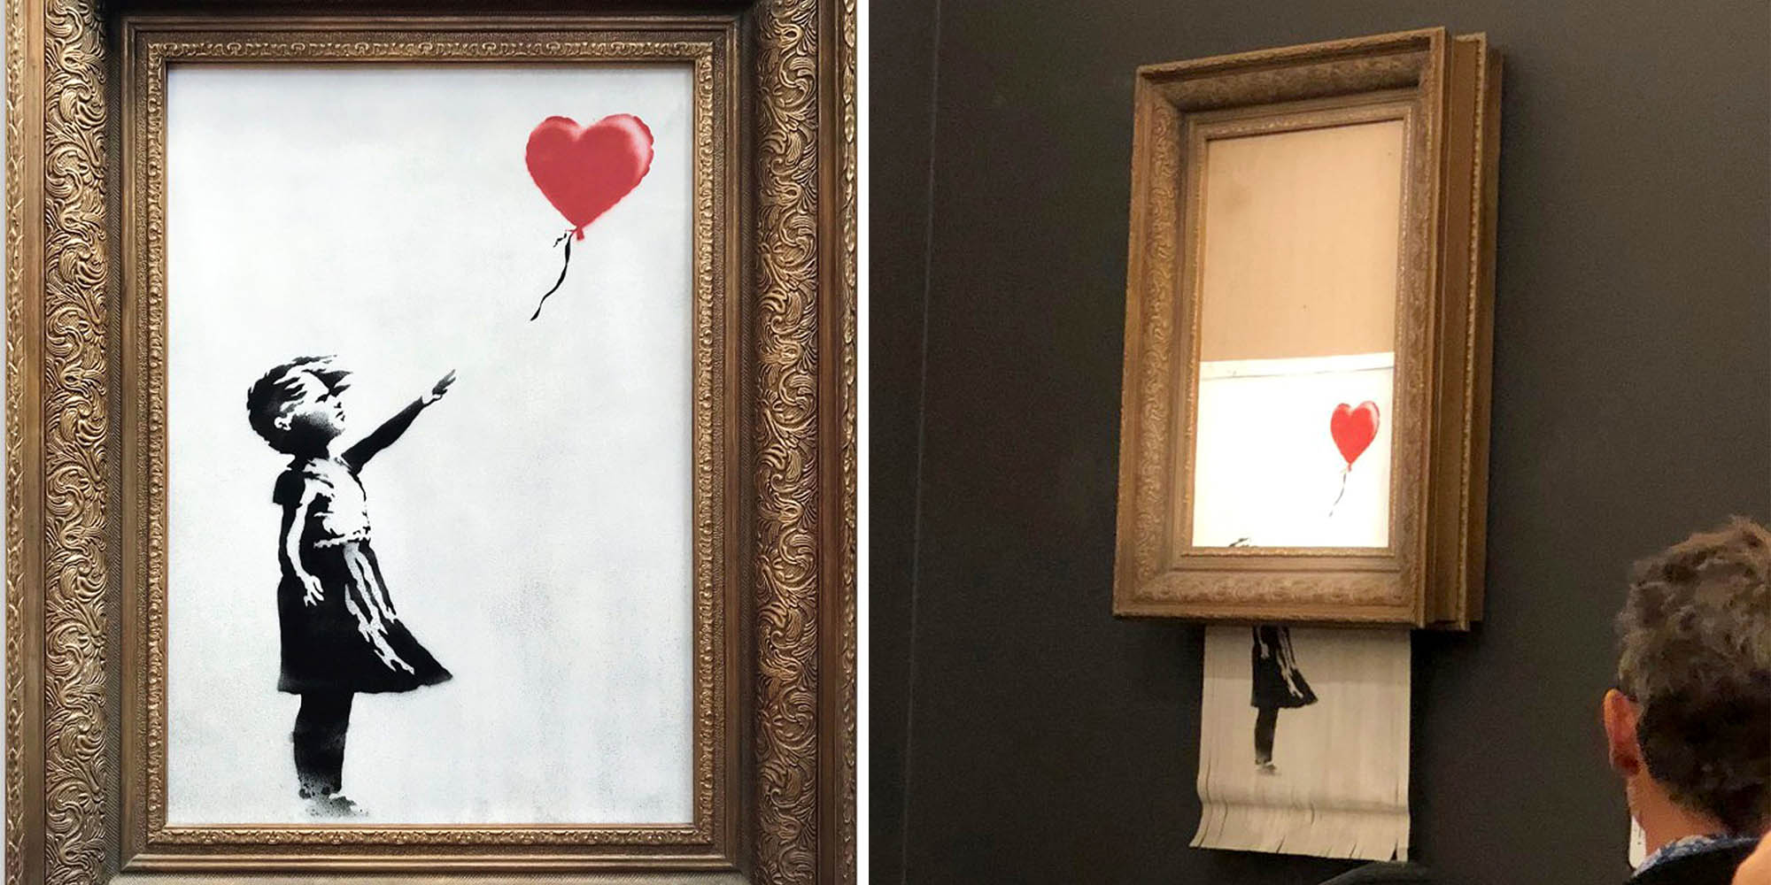

Slide 9
Pop art/Culture
Popular art is not art that has attempted and failed to be real art, but art that operates within the confines of the popular
While retaining much in common with folk art, it became an individual art, existing within a literate commercial culture

Slide 10
Introduction to Human Sciences
Literature Module
Lecture 3: The Written Text

Slide 11
Good or Great Culture
Some cultural artifacts are more valued than others
Intrinsic aesthetic/moral/spiritual value
Shakespeare – great because of something internal? Or have we been conditioned?
Text is important
Its values, and their histories, are to be questioned

Slide 12
English literature departments and the colonial project
Streamlining of certain literatures as superior to others
Does Meghadhoot reflect the lives of common people? Is the language accessible to anyone but a few? Greek, Latin, Roman texts

Slide 13
The British
Establish the first of the Literature departments in the country
European aesthetic and moral values
The analysis of Western imagination as typified by some of its luminaries: Alighieri Dante, William Butler Yeats, Samuel Taylor Coleridge, William Wordsworth

Slide 14
Were Shakespeare (1564-1616), Dickens (1812-1870), Sharat Chandra (1876-1938) meant to be high literature?
The case of India – anti-imperial move
The anti-imperialist hero comes via Europe
Raja Ram Mohan Roy, Michael Madhusudan Dutta, Vidyasagar, Tagore, Ranade, Dayanand Saraswati

Slide 15
Community in crisis
An intellectual class that is educated in the European tradition
Looking for traditional textual evidences for current malaise
Resurrecting ancient texts
Valorizing European ones

Slide 16
The very concept of Literature comes from this turmoil
To unify a cultural practice, establish it as good by European standards
Men of letters read, write and discuss proper literature
Formation of middle class and right “values”

Slide 17
What about the rest
Literacy, and access to literacy, gains primacy
Other literatures – written and oral
Middle Class vs low forms of education (kirtan, kathakathas, jatra, lavani, Parsi and Gujarati theatre)
Regional literatures – their reach, circulation and afterlives

Slide 18
Back to a hierarchy
What experiences get a readership; who are the marginalized
Between small regional publications and the Jaipur Lit Festival, lies a literary tradition that continues a legacy of colonialism and caste hierarchies

Slide 19
Battling old demons
Rushdie – Midnight’s Children (1981)
Lauded as a continent finding its voice in the West
Is there one voice? Is the voice of the continent English?
Major literary traditions in Marathi, Tamil, Bangla, Assam, Mizoram, Kannada, Malayalam

Slide 20
“World” Lit./ “Third World” Lit
English writing from the Global South becomes representative of a nation’s literary production and identity
Binary relationship between first and third world, us/US/Europe vs the world
The political category of the nation
Rushdie is the voice of “Islam” or of “India” depending on the book

Slide 21
Does it matter
Lit. exists in a variegated terrain
Does it matter, who to, why, under what circumstances?
Why do states bother with censorship?
Writers, poets, lyricists, stand-up comedians – arrested, banned, jailed, killed
Gaddar, Safdar Hashmi, Taslima Nasreen, Sushmita Banerjee, even Gulzar. Manto, Faiz

Slide 22
Literature – Contested site
The Satanic Verses (Salman Rushdie, 1988)
Banned in India before it was banned in Iran
Khomeini issues fatwa to kill Rushdie in 1989
Rushdie goes into hiding in the UK
Divided Muslims from Westerners along lines of culture
Freedom of expression vs Blasphemy

Slide 23
Who read The Satanic Verses ?
English speaking and literate readership
Very few people in Iran and India would have bothered
Why then do states continually intervene?
Why is power afraid of the imaginative text?
What offends – Kashmir Files vs Parzania
Udta Punjab

Slide 24
Two thoughts
A thinking culture is dangerous – organic, mutative, resistant
A cultural text is bound. All arms of the Humanities are needed to make it organic, relevant

Slide 25
Pride and Prejudice (1813)
It is a truth universally acknowledged, that a single man in possession of a good fortune must be in want of a wife.
However little known the feelings or views of such a man may be on his first entering a neighbourhood, this truth is so well fixed in the minds of the surrounding families, that he is considered as the rightful property of some one or other of their daughters.

Slide 26
Ajanta Deo (2019)
कौन अपनी बेटी को चिड़िया कहता है सिर्फ़ चिड़िया कहने से घर आसमान नहीं हो जाता ।

